Slide 1






PRESENTATION 2026
Student Name
Student Email
A.R. Anisha Priyatharshini
anishapriyadharshini12@gmail.com
Mentor Name
Uma Maheshwari

Slide 2

Project Title :
Employee Payroll Data Cleaning And Financial Analysis

Slide 3
Outline
Abstract of the Project
Problem Statement
Proposed Solution
System Architecture
Live Demo of the Project
Embedded Video of Project
Conclusion
Future Scope

Slide 4
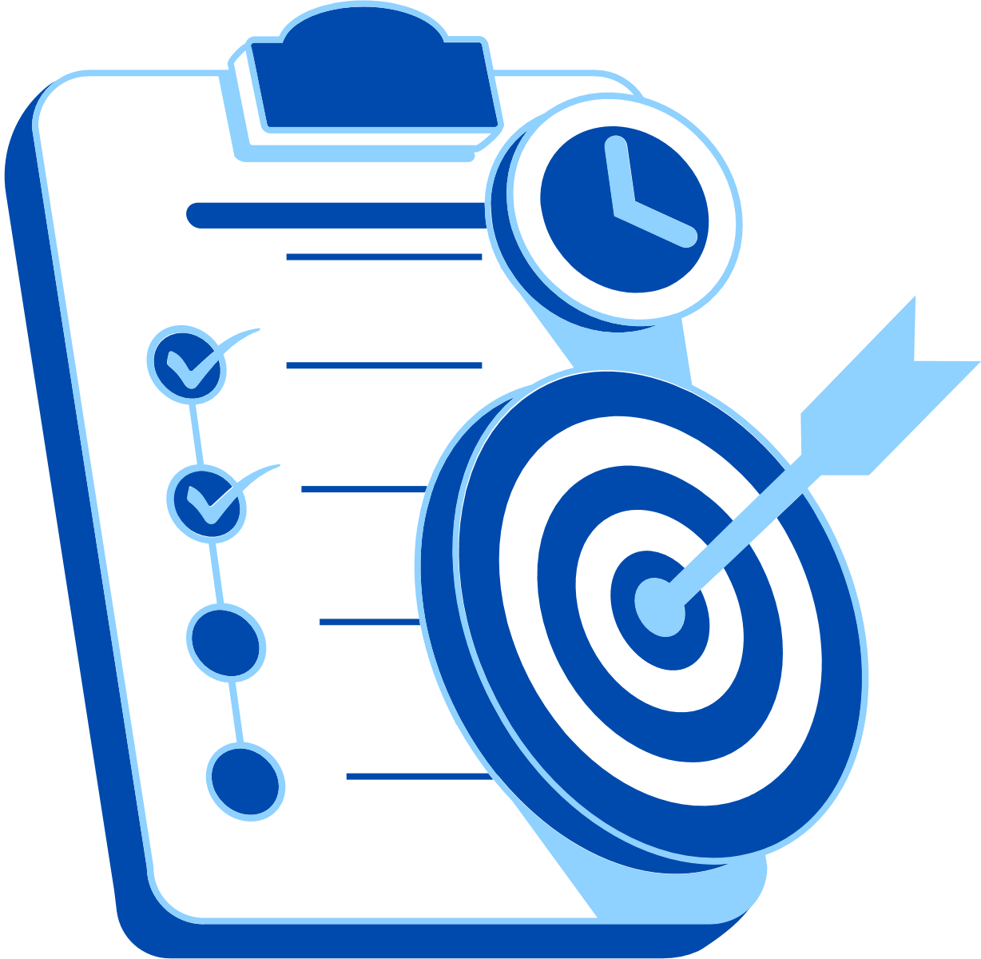
Abstract
This project, Employee Payroll Data Cleaning And Financial Analysis, focuses on transforming raw payroll data into meaningful financial insights.
Objective: To clean and standardize employee payroll records and analyze salary-related information for better financial understanding and decision-making.
Tools: Excel (Formulas), Power BI (Dashboards, Charts, KPI Cards), AI Tools (ChatGPT & Microsoft Copilot)
Expected outcomes: Include cleaned payroll datasets, interactive dashboards, department-wise salary analysis, payroll summaries, and AI-assisted insights for payroll management.
Highlight: The employee payroll dataset is cleaned using preprocessing techniques such as duplicate removal, formatting, and standardization, followed by financial visualization and dashboard creation enhanced with AI assistance.

Slide 5

Problem Statement
Organizations manage large volumes of employee payroll records containing salary, allowances, bonuses, tax deductions, and department information.
Difficulty in identifying top-performing products, regional variations, and discount effectiveness.
Managers struggle to convert raw data into actionable insights.
This project addresses the inefficiency of raw datasets, the gap between data and insights, and the need for AI-driven storytelling to complement dashboards.

Slide 6

Proposed Solution
Collecting and understanding the Employee Payroll Dataset.
Cleaning and preprocessing the data: (handling duplicates, inconsistent salary formats, and date standardization).
Applying payroll financial analysis: (department-wise salary analysis, tax deduction analysis, employee distribution).
Building interactive dashboards with: (KPIs such as total employees, total net salary, allowances, and average salary).
Integrating AI tools: Microsoft Copilot and ChatGPT for data cleaning guidance, financial insights, and dashboard assistance.

Slide 7
System Architecture
Data Input / Source
Processing / Analysis
Data preprocessing: standardized salary and date formats.
Financial analysis using Excel formulas and Power BI visualizations.
Employee Payroll Dataset (Excel/CSV format)
AI / Tool Integration
Output / Dashboard
Microsoft Copilot for automated cleaning
Suggestions.
ChatGPT for payroll analysis assistance and
workflow guidance.
Interactive Payroll Dashboard, Department-wise salary charts, Pie charts and bar charts
KPI cards, payroll summaries and AI-assisted financial insights

Slide 8
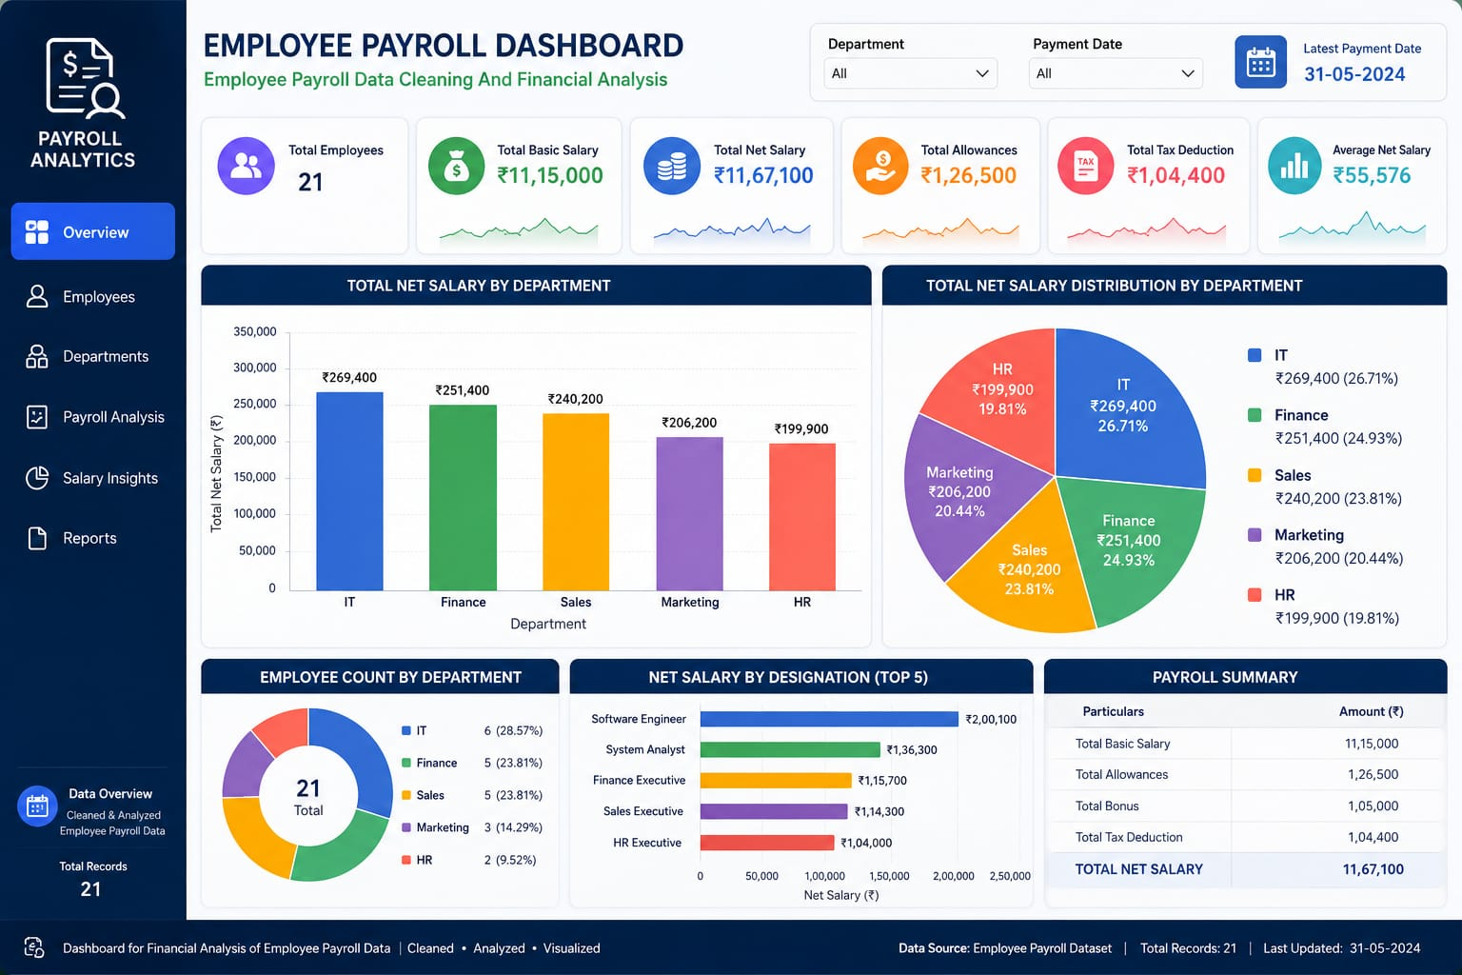

Slide 9
Live Demo of Project
Here's the list of some demo screenshots / features of the project:
Demo 1
Demo 2​
Demo 3
Employee Payroll Dataset​
AI Tool Integration​
Payroll Charts ​

Slide 10
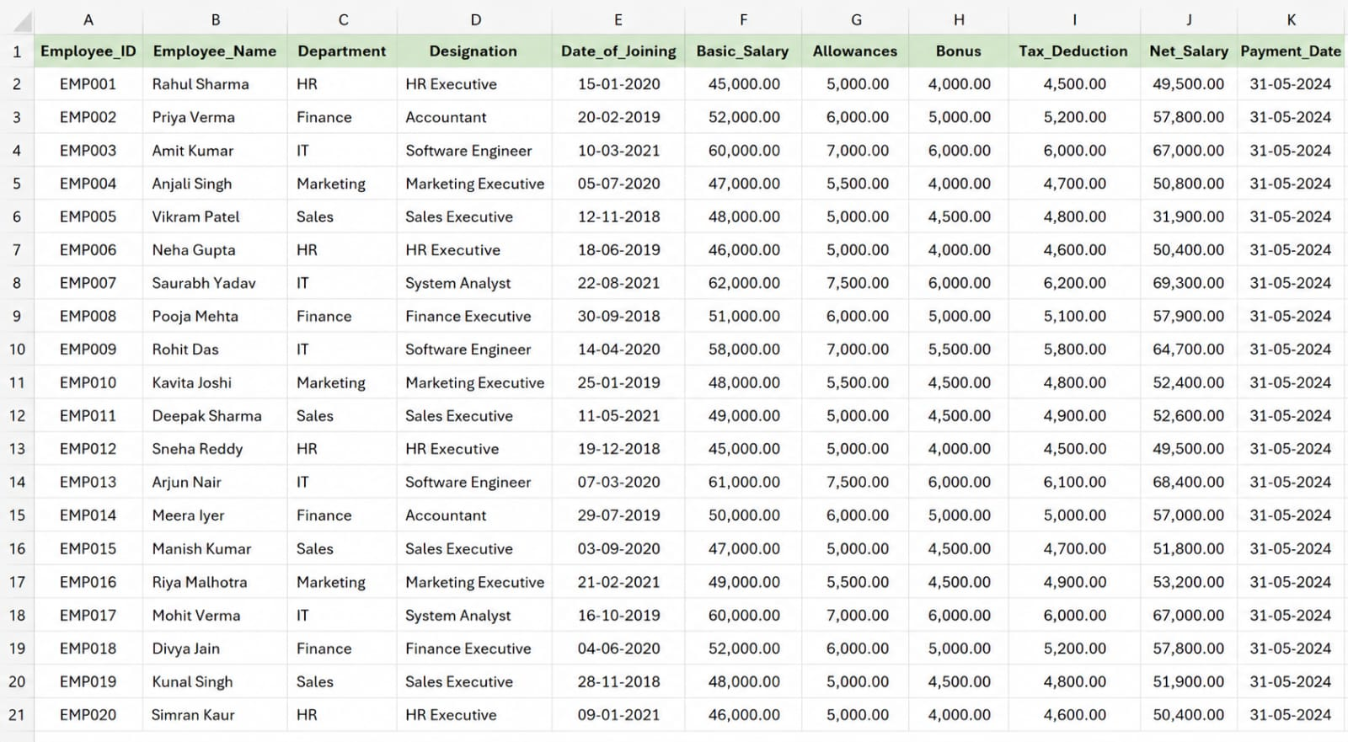
Demo 1 : Employee Payroll Dataset
▶
Video of Project Demo
[https://github.com/anishapriyadharshini/Employee-Payroll-Data-Cleaning-And-Financial-Analysis-.git]

Slide 11
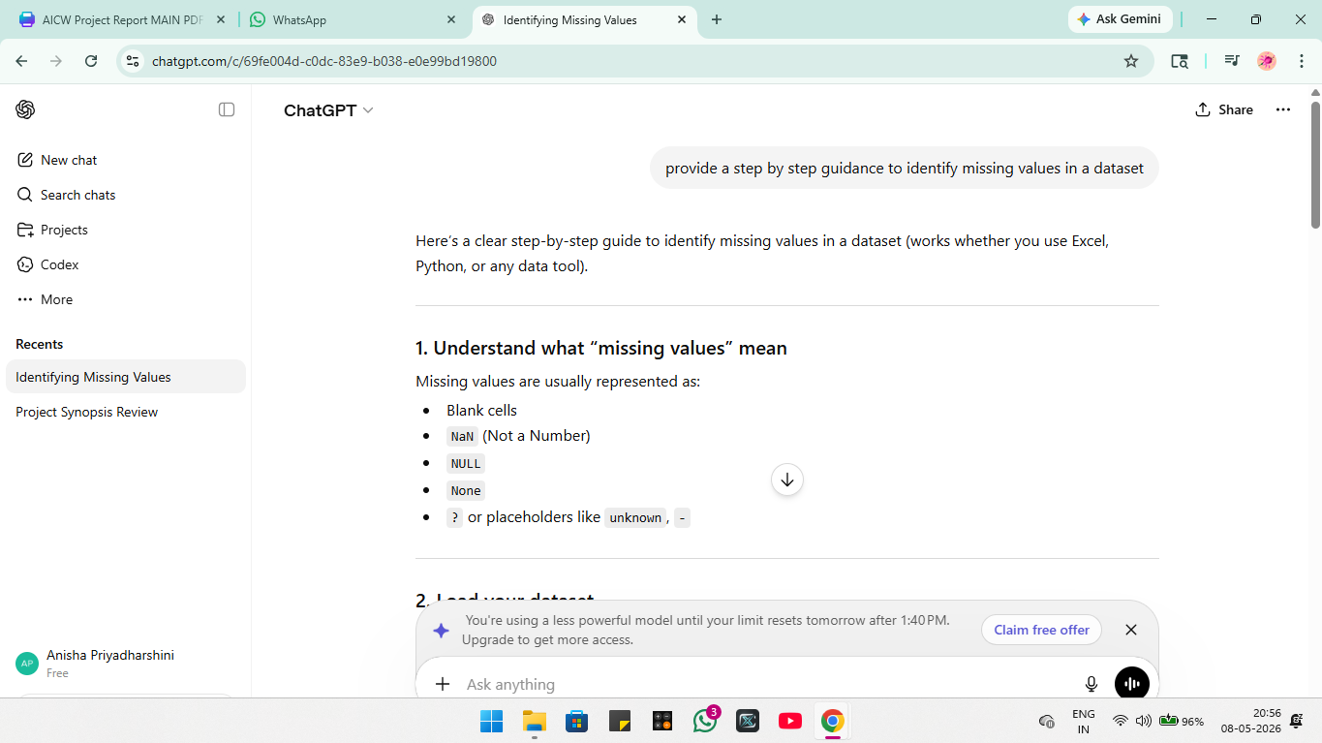
Demo 2 : AI Tool Integration
▶
Video of Project Demo
[https://github.com/anishapriyadharshini/Employee-Payroll-Data-Cleaning-And-Financial-Analysis-.git]

Slide 12
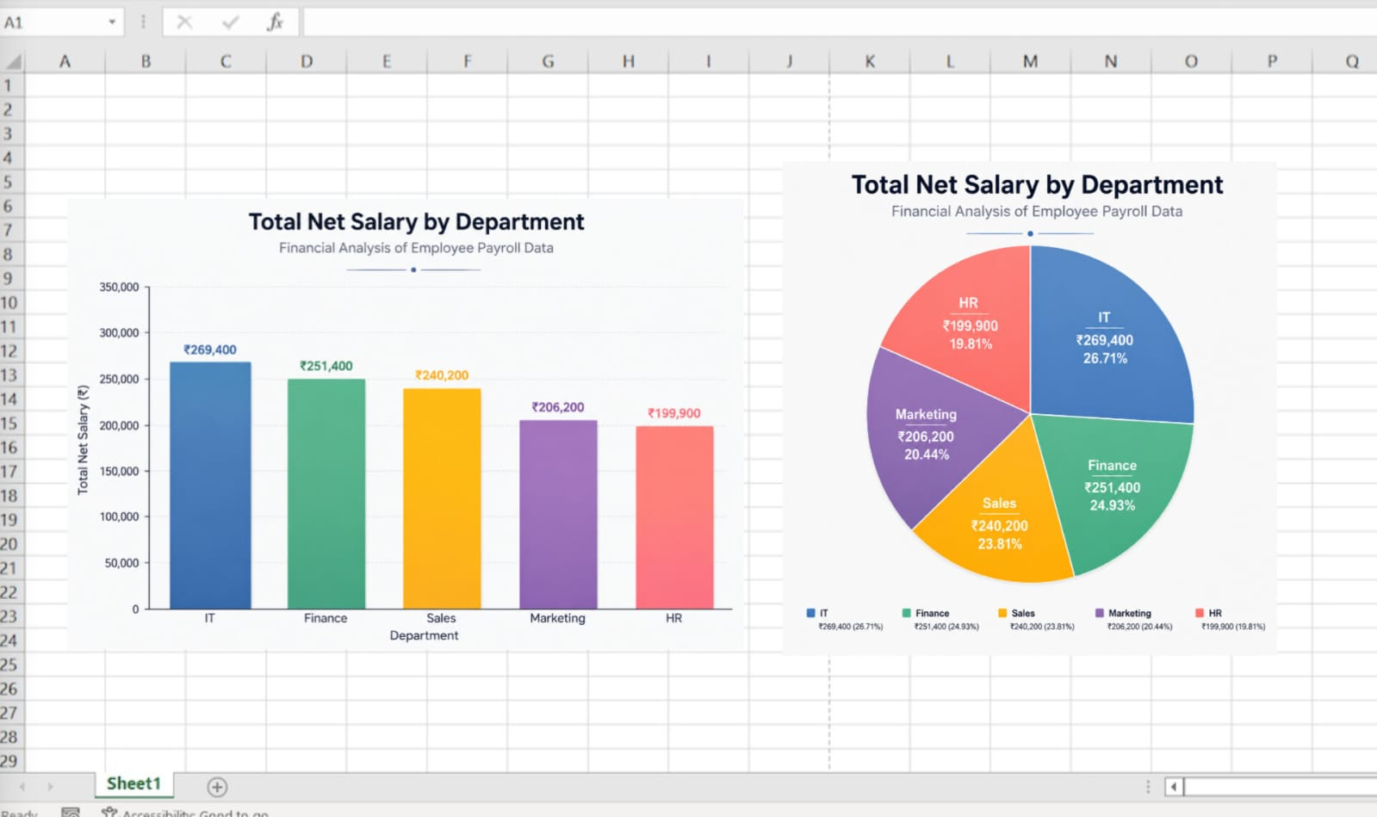
Demo 3 : Payroll Charts
▶
Video of Project Demo
[https://github.com/anishapriyadharshini/Employee-Payroll-Data-Cleaning-And-Financial-Analysis-.git]

Slide 13
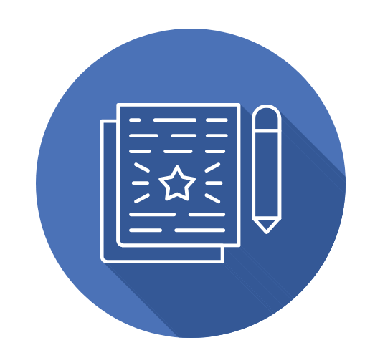
Conclusion
This project successfully demonstrates how payroll data cleaning and financial analysis can convert raw employee records into meaningful business insights.
✔ Achievements:-
Cleaned and standardized payroll dataset
Removed duplicate and inconsistent records
Built interactive payroll dashboard
Created charts for salary analysis
Generated AI-assisted insights using ChatGPT and Microsoft Copilot
CONCLUSION

Slide 14
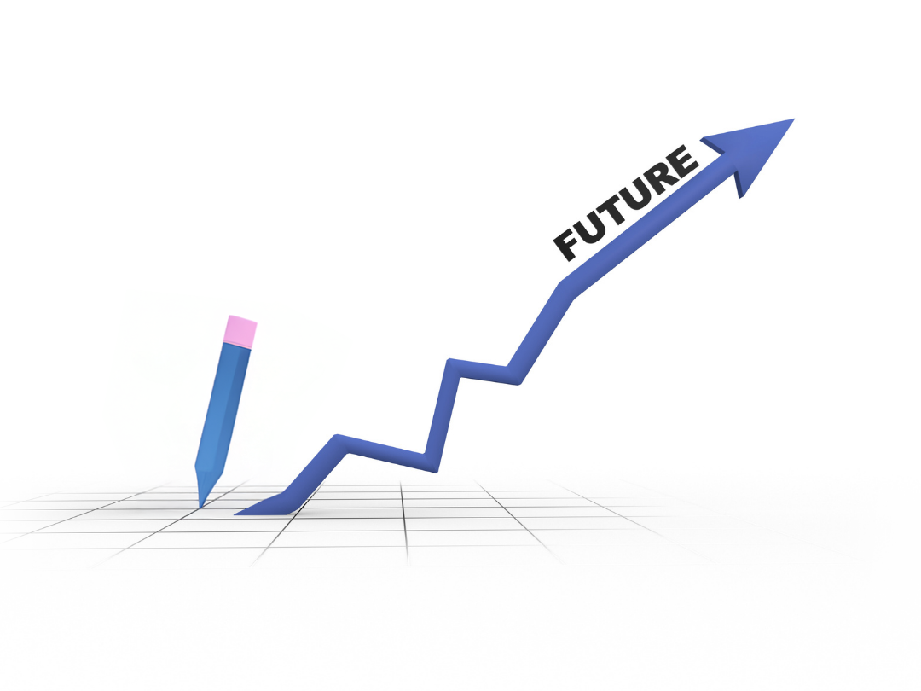
Future Scope
Expand payroll dataset with monthly and yearly payroll records.
Integrate predictive analytics for salary forecasting.
Add employee performance and attendance analysis.
Deploy dashboards on cloud-based BI platforms.
Integrate payroll analysis with HR management systems.

Slide 15
Thank You
AICW Fellowship | Student Project Presentation 2026
LinkedIn | Edunet Foundation

